Slide 1

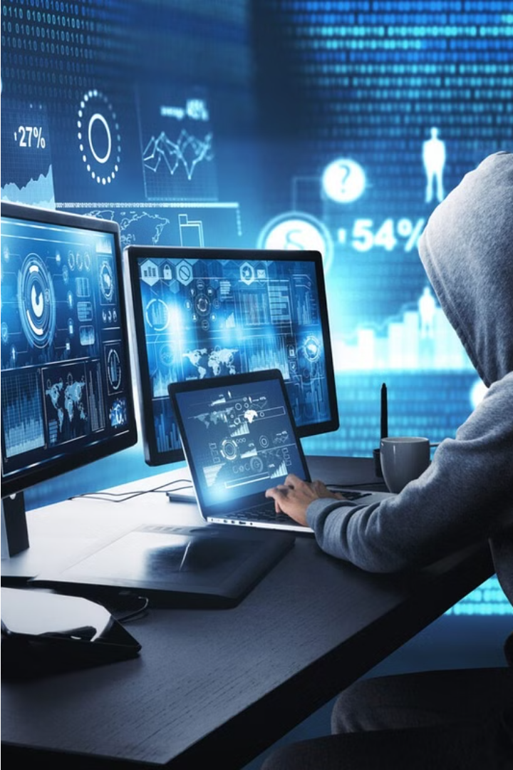

Introduction to Computer Crime Investigation
Computer crime investigation is a critical field that involves the systematic examination of digital evidence to identify, track, and prosecute cybercriminals. This process requires specialized skills and advanced forensic techniques to uncover the complex details of digital crimes.

Slide 2
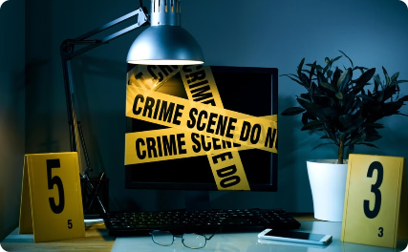

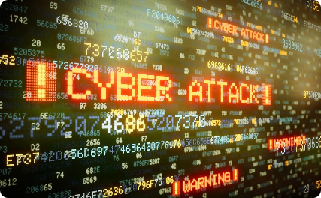
Defining Computer Crime
Understanding the Scope
Evolving Threat Landscape
Importance of Proactive Measures
Computer crime encompasses a wide range of illegal activities that involve the use of digital technologies, from hacking and cybertheft to online fraud and malware distribution.
As technology continues to advance, the nature and complexity of computer crimes are also constantly evolving, posing new challenges for law enforcement and digital forensics experts.
Effective prevention and mitigation of computer crimes require a multifaceted approach that combines technical safeguards, user awareness, and robust incident response protocols.

Slide 3




Gathering Digital Evidence
Identify Data Sources
Locate all potential digital sources, including computers, mobile devices, cloud storage, and network logs that may contain relevant information.
Secure the Scene
Ensure the crime scene is properly secured to prevent the alteration or destruction of digital evidence. Isolate devices and restrict access.
Capture Volatile Data
Quickly collect ephemeral data that could be lost, such as RAM contents, network connections, and running processes.
Handle with Care
Carefully handle all digital devices to avoid contamination or damage. Use specialized tools and techniques to create forensic images and backups.

Slide 4
Forensic Analysis Techniques
1
Data Extraction
2
File System Analysis
Forensic experts use specialized tools to acquire and extract digital evidence from devices, ensuring the integrity and admissibility of the data.
Analyzing the file system structure, metadata, and deleted files can reveal valuable information about user activities and potential criminal actions.
3
Network Forensics
4
Malware Detection
Capturing and examining network traffic can help identify communication patterns, connections, and potential unauthorized access attempts.
Forensic analysts use reverse engineering and dynamic analysis techniques to identify and investigate malicious software that may be involved in the crime.

Slide 5
Preserving Chain of Custody
Secure the Scene
1
Restrict access and document all entry/exit.
Identify Devices
2
Catalog all electronic devices at the scene.
Package Properly
3
Store evidence in anti-static bags or containers.
Maintaining a proper chain of custody is critical in computer crime investigations. This involves securing the scene, identifying and cataloging all relevant digital devices, and carefully packaging the evidence to prevent contamination or tampering. Each step must be thoroughly documented to ensure the integrity of the evidence during the investigation and any subsequent legal proceedings.

Slide 6
Identifying Suspects and Motives
Suspect Profiling
Motive Analysis
Investigators analyze digital activity patterns, online footprints, and behavioral clues to identify potential suspects. This may involve tracing IP addresses, usernames, and other digital identifiers.
Understanding the motivation behind the alleged computer crime is crucial. Investigators examine factors such as financial gain, revenge, ideology, or thrill-seeking to uncover the suspect's underlying motives.

Slide 7





Executing Search Warrants
Obtain Warrant
1
Secure a lawful search warrant from a judge or magistrate
Secure the Scene
2
Ensure the safety of all involved and prevent destruction of evidence
Conduct Search
3
Methodically search the premises as outlined in the warrant
Collect Evidence
4
Carefully document and seize all relevant digital devices and data
Chain of Custody
5
Maintain strict control over the evidence to preserve its integrity
Executing a search warrant is a critical step in a computer crime investigation. Investigators must first secure a lawful warrant from a judge, then proceed to the location in a controlled manner, ensuring the safety of all involved. The search must be conducted systematically, with each piece of digital evidence carefully documented and seized to maintain the chain of custody.

Slide 8


Extracting and Analyzing Data
Data Extraction
Forensic Analysis
Carefully extract data from seized devices and digital media, preserving the integrity of the evidence through proven forensic techniques.
Conduct in-depth forensic analysis to uncover hidden files, deleted data, and other crucial evidence using specialized software and tools.
Timeline Reconstruction
Reconstruct a detailed timeline of events by analyzing timestamps, user activity, and other metadata, painting a clear picture of the crime.

Slide 9



Reporting and Documentation
Detailed Records
Timeline of Events
Courtroom Readiness
Maintain comprehensive, detailed records throughout the investigation process, documenting every step and piece of evidence gathered.
Construct a detailed timeline of the incident, recording key dates, times, and actions taken during the investigation.
Organize all evidence and findings into a clear, concise report that can be effectively presented in a court of law.

Slide 10

Courtroom Presentation and Testimony
Courtroom Preparation
1
Carefully review all evidence, documents, and witness statements to ensure a thorough understanding of the case. Anticipate potential questions and prepare clear, concise responses.
2
Delivering Testimony
When called to the stand, speak clearly and confidently. Provide factual, unbiased testimony based on the digital evidence gathered. Avoid speculation and stick to your area of expertise.
Demonstrating Evidence
3
Use visual aids, such as forensic reports or data visualizations, to effectively present the digital evidence to the court. Explain technical details in plain language that the jury can understand.

